Slide 1
Using Innovation Games® and Visual Facilitation for Product Development at Scale
Peter Ferak
bwin
Alex Staenke
The Thinking Company

Slide 2
Hello

Slide 3
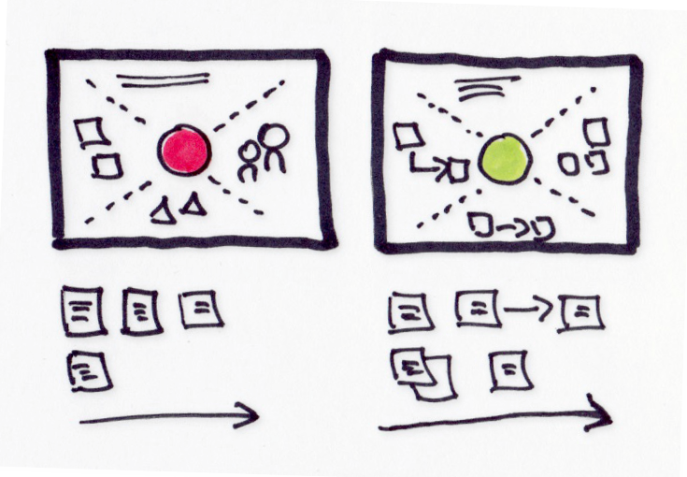




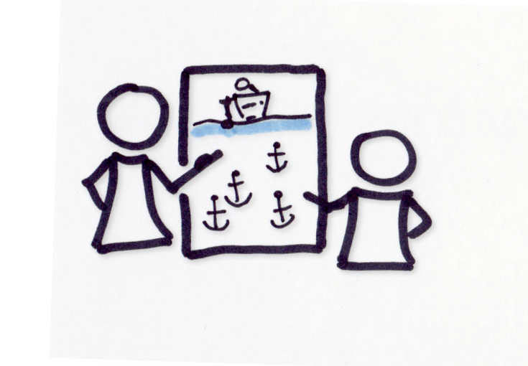
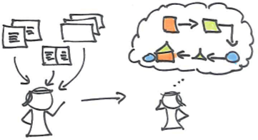
Alex Staenke
The Thinking Company
thinking-company.at
Effective Collaboration
in Projects & Teams
icons by Zlatko Najdenovski
Innovation Games®
Innovation, Market Research, Agile Processes
Visual Thinking Communication, Collaboration, Creativity

Slide 4
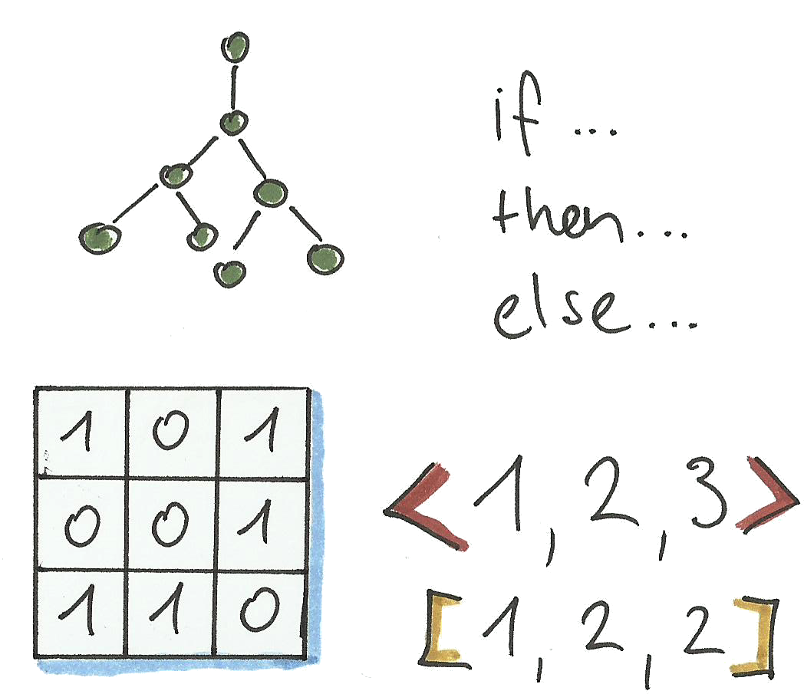
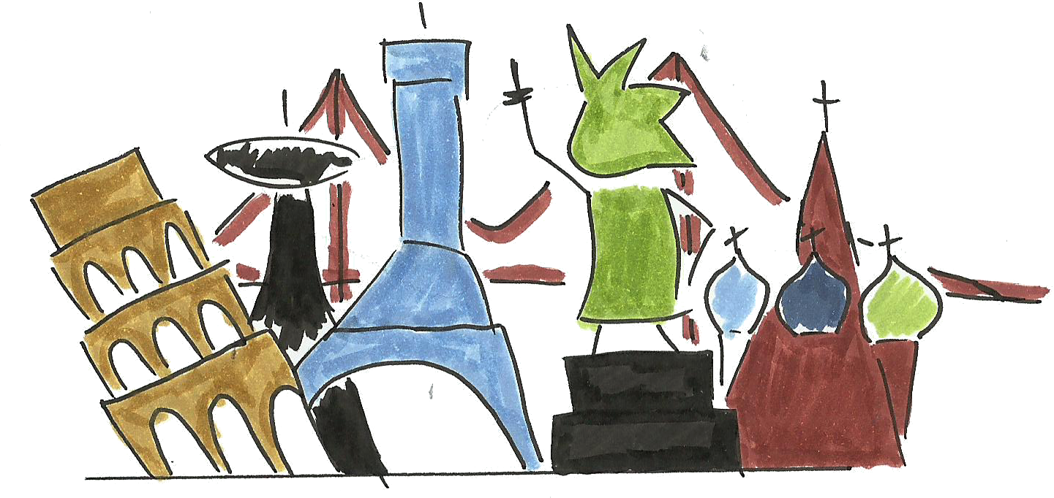
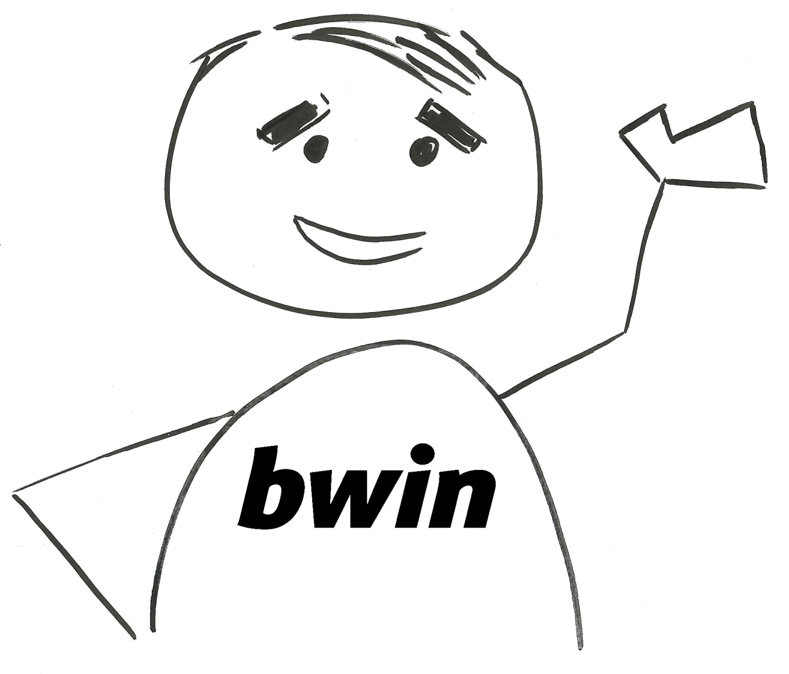
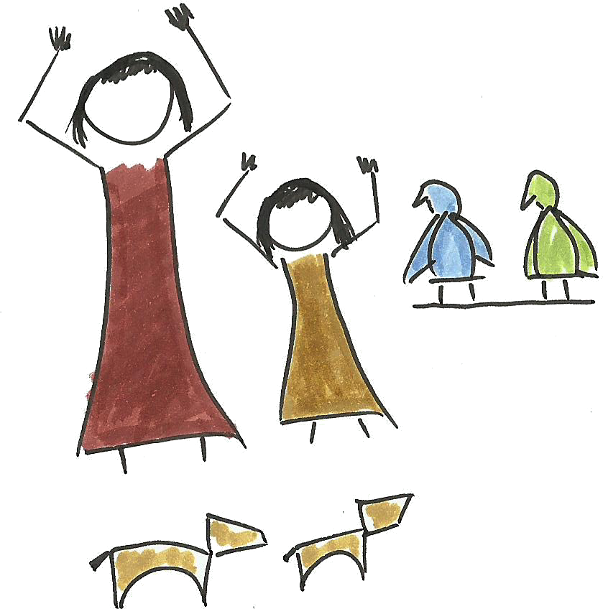
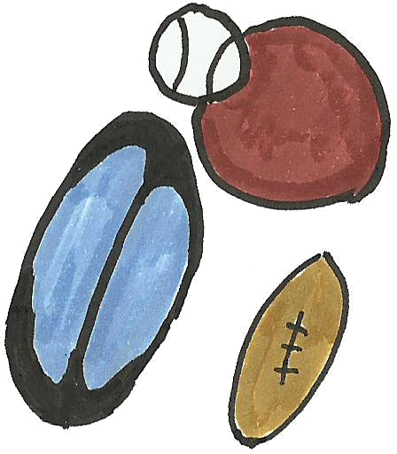
Peter Ferak
Developer Lead, Agile Coach, DevOps

Slide 5
Agenda
The bwin Software Eco-System
Agile Product Development at Scale
Problem Solving and Serious Games
Innovation Games® at Scale

Slide 6

Evolution of the bwin software system

Slide 7




Addition of manpower
Additional Languages
B2B Partnerships
Poker
Payments
Casino Games
Loyalty Store
2500
1600
Referral system
300
Startup
12
50
1997
2000
2006
2011
2013
2016

Slide 8
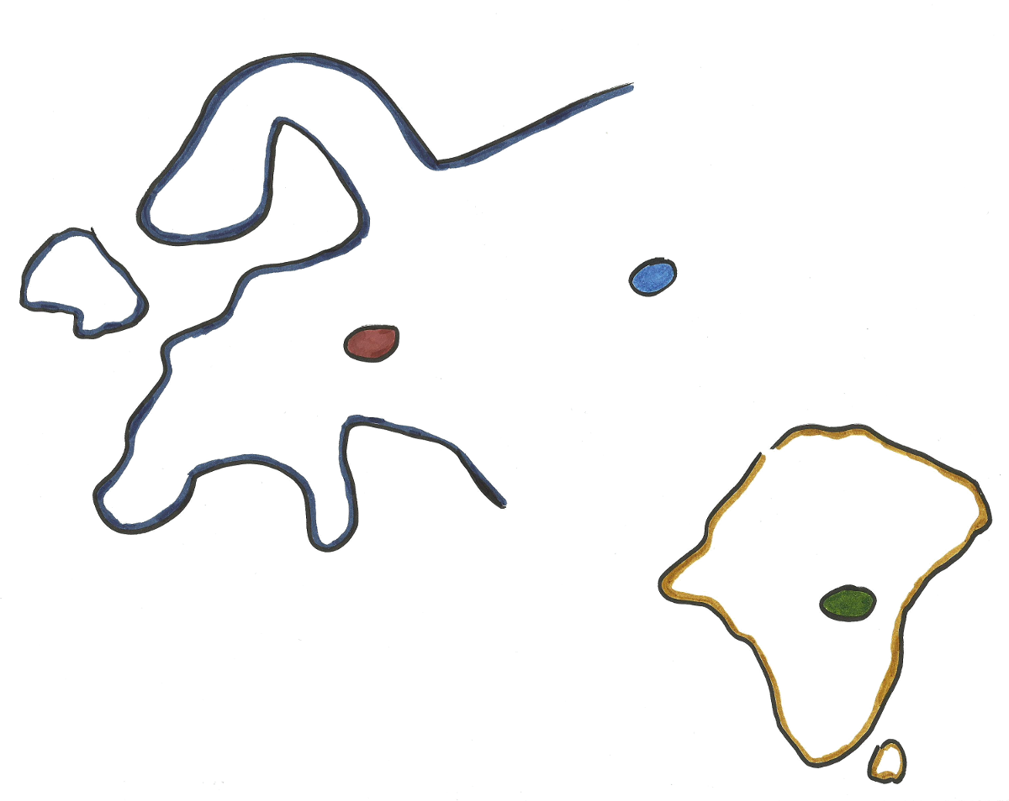
Distributed development centers
Kiev
Vienna
Hyderabad
90 scrum teams in 7 locations

Slide 9
Conway‘s Law
“Organizations which design systems are constrained to produce designs which are copies of the communication structures of these organizations.”
- Melvin Conway

Slide 10

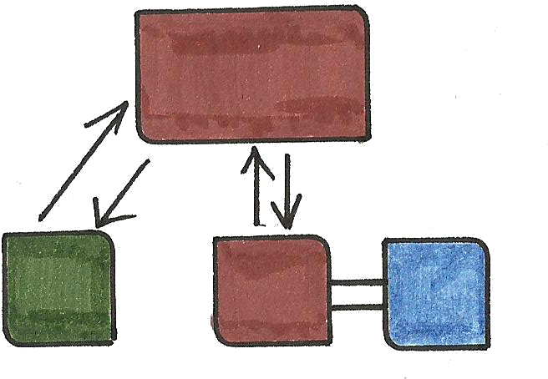


Growing technical complexity through dependencies

Slide 11
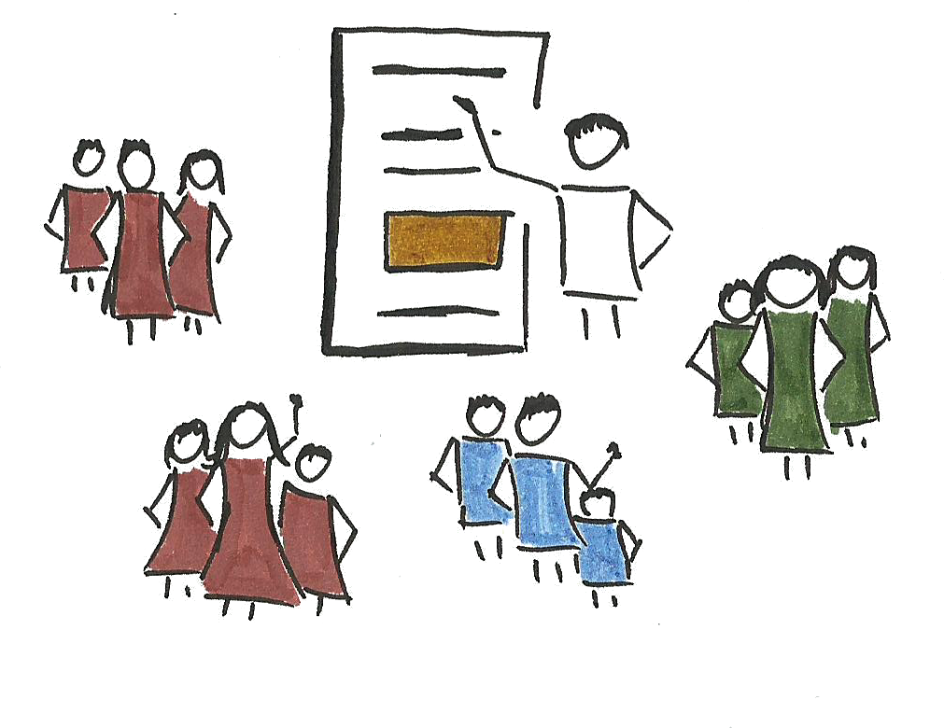
Growing process complexity

Slide 12
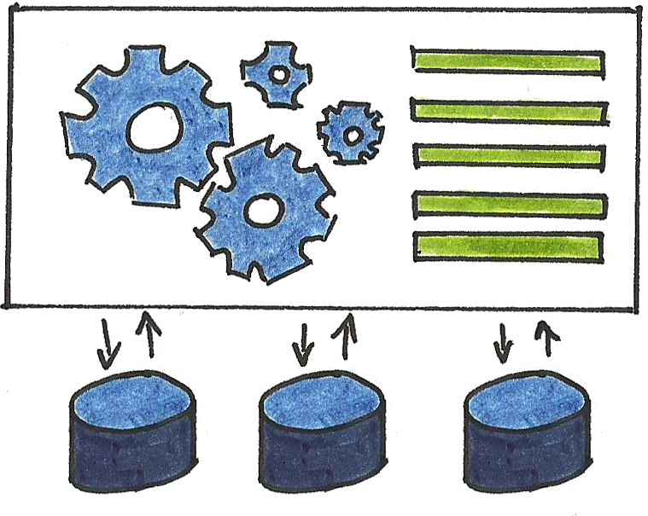
One software system
More than 1m lines of code, 2.500 servers
50 independent deployable systems
120 components
20 independent database schemas
Betting Engine
Sports Trading
30 independent deployable systems
15 independent database schemes

Slide 13

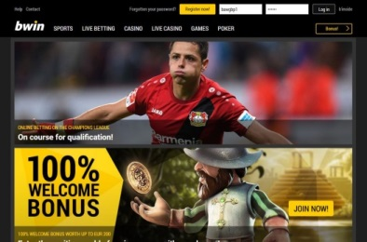

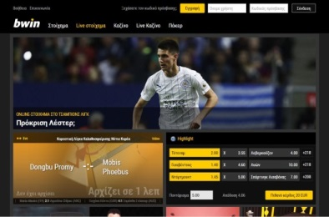
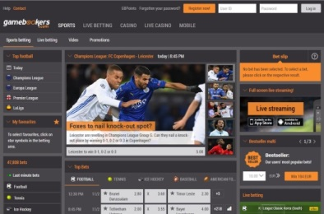


Government regulations
bwin.com
bwin.it
bwin.gr
gamebookers.com
partybets.com
partypoker.com
Outages cost € in not wagered bets and bad customer experience!

Slide 14

Evolving system
Loyalty
Casino
Regulations
Regulations
Poker
Poker
Live betting
Live betting
Live betting
Online betting
Online betting
Online betting
Online betting
1997
2000
2006

Slide 15




More than 1.000.000 € wagered every day
Typically 140.000 concurrent customers
Typically 1.3m unique customers a day
Up to 2500 login requests per minute
Up to 1.5m bet placements per day
30.000 different Sports bets a day
In 90 Sports
Up to 50.000 Tournaments a day
Average 383.000 hands of Blackjack per day
Average 704.000 Roulette spins a day
Average 10.6m Slot spins a day

Slide 16
Agenda
The bwin Software Eco-System
Agile Product Development at Scale
Problem Solving and Serious Games
Innovation Games® at Scale

Slide 17
Agile product development at scale

Slide 18
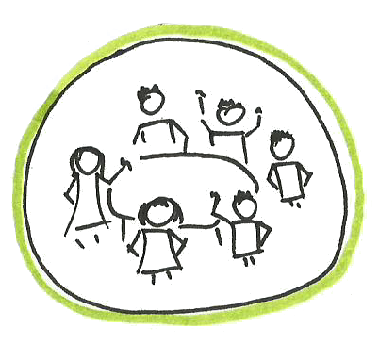

Steering
Q1
Q2
Q3
Q4
P1
P2
P3
P4

Slide 19


Sizing

Slide 20
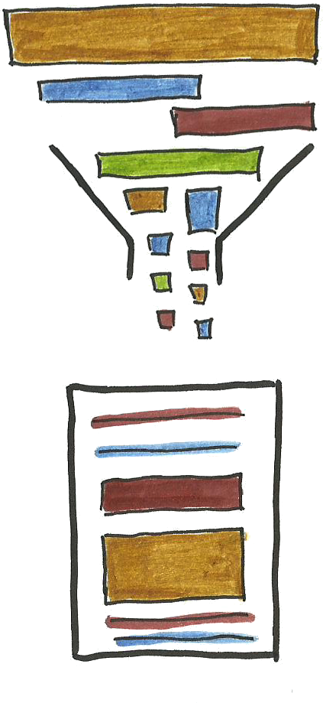


Refinement

Slide 21
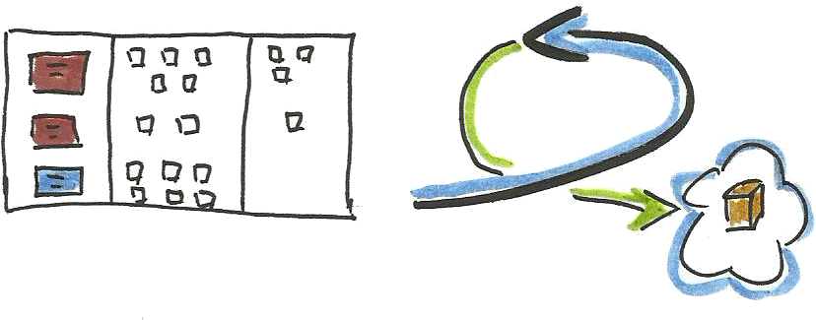
Delivery

Slide 22

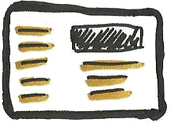
Happy Customer

Slide 23

Feedback loops
ROI
Customer usage
Features
Bugs
Incidents
Epics
Items
Requirements
Implementation
Software

Slide 24

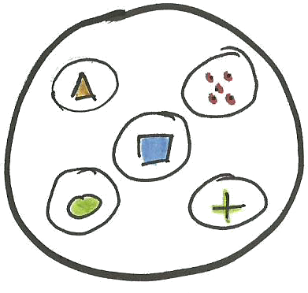
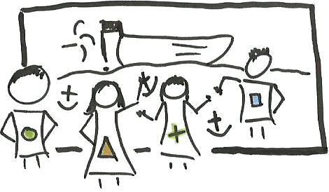


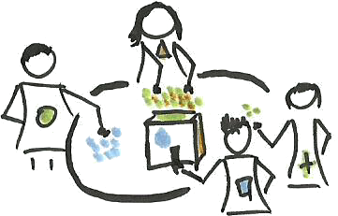
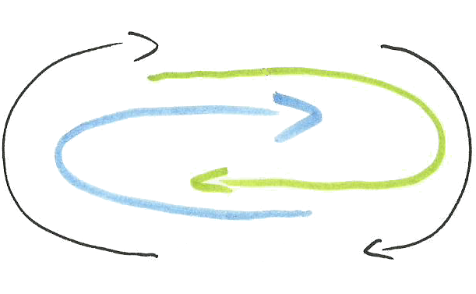
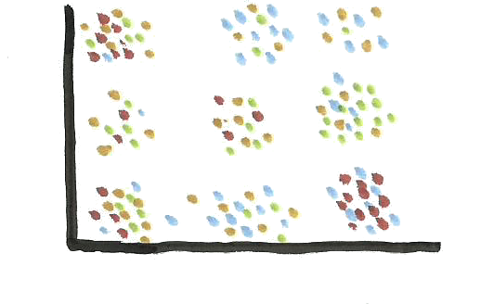
Diverse Teams
Visual
Customer
And Product First
Collaborative
Simplicity
Engaging
Face to Face
Inspect
Scalable
Adapt

Slide 25
Changing the Organization

Slide 26










Through more focus on Agile
Deployment and iteration speed
Break down silos
More reliable and
robust system
Smaller batches
Engage entire company in the transition

Slide 27
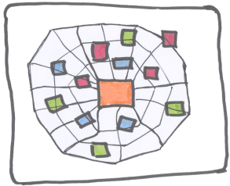



And new ideas
Luke Hohmann
“Traditional retrospectives focus on a single co-located team. They can produce results that improve the performance of the team, but often fail to address the needs of the enterprise – the issues affecting multiple teams or beyond the scope of control of and single team.“

Slide 28
Agenda
The bwin Software Eco-System
Agile Product Development at Scale
Problem Solving and Serious Games
Innovation Games® at Scale

Slide 29

Solving Problems in Teams

Slide 30
Challenges During Development
In every phase of the development cycle we are confronted with different challenges:
Find the right vision & strategy
Create a good roadmap
Understand what the customer needs
Define requirements & create user stories
Prioritize features

Slide 31
Software Development Problem Solving
is

Slide 32
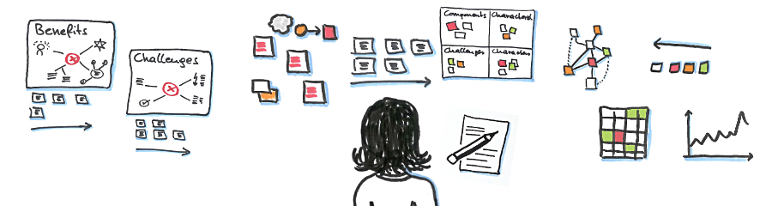
Software development is a complex process that requires a team to collaboratively solve many problems over an extended period of time.

Slide 33

What makes teams powerful?
Different backgrounds & expertise
Different perspectives
Different understandings and
Different intentions and motivations

Slide 34
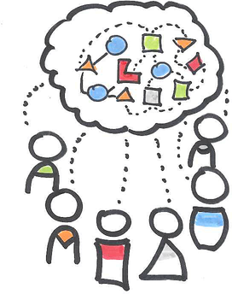
Teams exhibit Diversity
Diversity increases the social complexity of a team.
Diversity makes collaboration and problem solving harder.

Slide 35
Software development is collaborative problem solving with a diverse team.

Slide 36
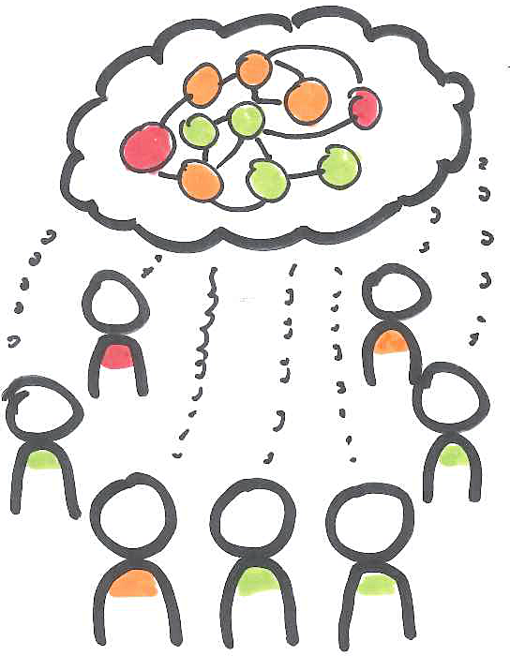
Good Problem Solving needs…
Shared understanding of the problem and its possible solutions.
Effective idea exchange and good communication between all team members.

Slide 37
The Agile Manifesto
Notes:
The ideas in the agile manifesto give us some direction on how to achieve shared understanding and effective idea exchange.

Slide 38
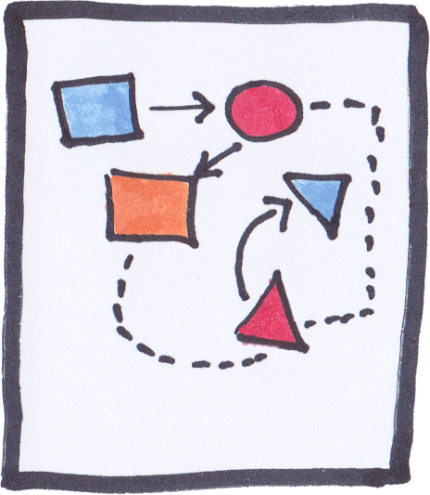

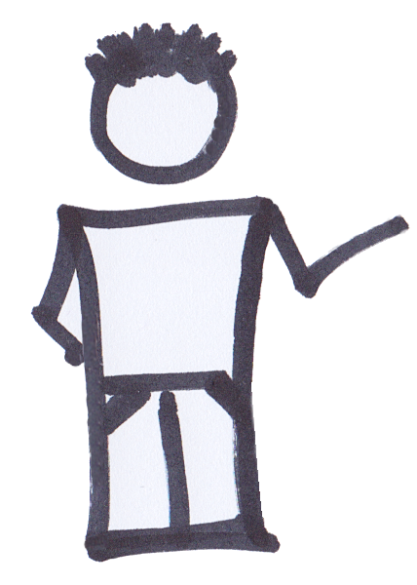
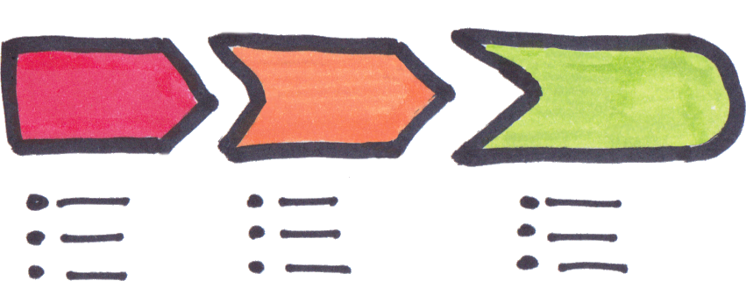

Individuals & Interactions
over Processes and Tools

Slide 39

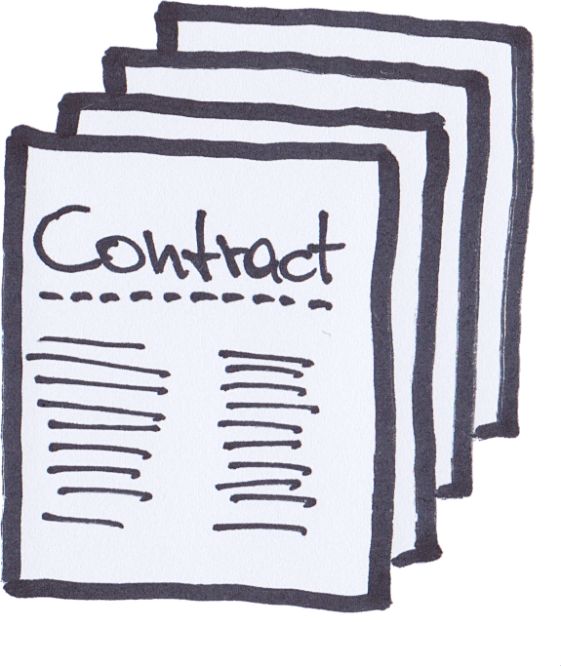
Customer Collaboration
over Contract Negotiation

Slide 40
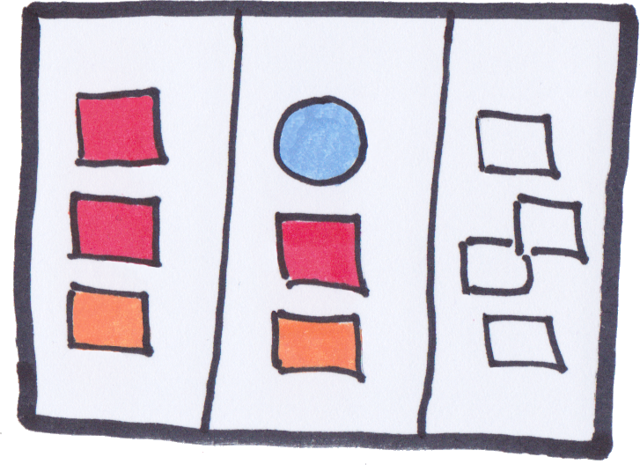


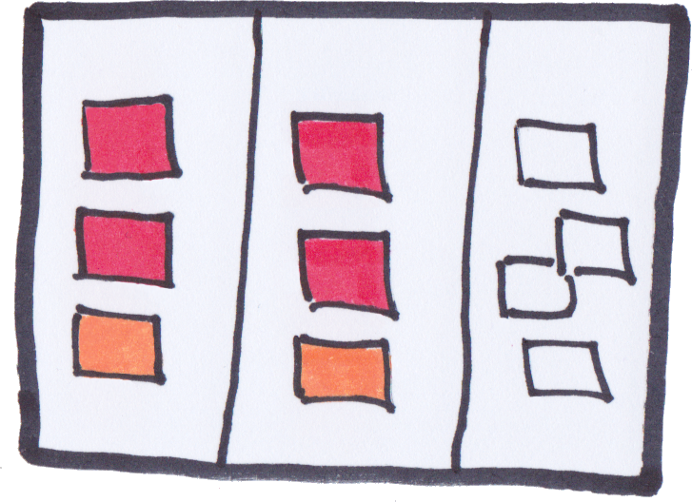
Responding to Change
over Following a Plan

Slide 41
Serious Games & Problem Solving
Notes:
So how is all this connected? Software development is a complex process that requires a team to collaboratively solve problems. The Agile Manifesto tells us what to do. And with Serious Games we have a very effective methods for the HOW. How do we collaborate with the customer? How do we design interactions? How do we prioritize features - etc

Slide 42
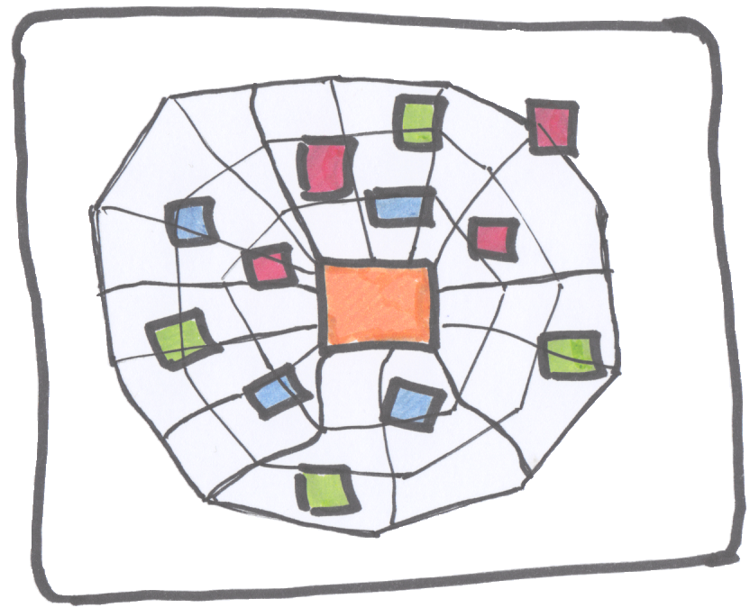
Why use “Games”?
Because games are a great way to create shared understanding in teams with high social complexity.

Slide 43

Games Create a Safe Playground
A game creates a safe space for social interactions and learning.
In a game we are able to try out new things without threatening our social standing.
A game makes taking on new perspectives easy and fun.
Notes:
Why do we need “safe” space?
Because sometimes people have great ideas but aren’t comfortable in sharing them publicly.
Because sometimes things need to be questioned
Because sometimes we need new perspectives

Slide 44
With Serious Games it is easy to…

Slide 45
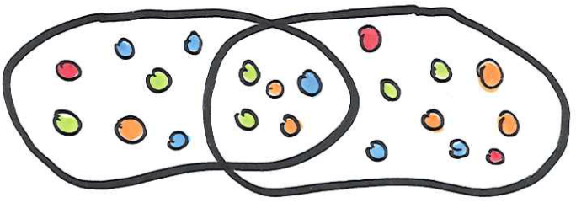


Develop shared understanding, involve and engage all team members, create and exchange new
ideas effectively and have fun while doing so.

Slide 46
Examples

Slide 47
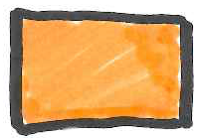
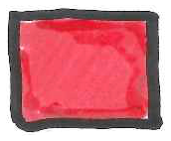


Spiderweb Understand Product Relationships
Notes:
Invite your customers and / or team members to find out how they see your product or service. What do they think is related to it? With the Spiderweb you get a full picture of how different users view your product or service.
How is it played: You place the product or service at the center and ask participants to silently think about all the things that they think are related to your product or service. They then place one idea per post-it on the spiderweb wherever they think it fits.
When everyone is done you can discuss, cluster, sort, …
Benefits: 1) You get different perspectives 2) you get “user-generated” content – meaning: it’s what they think
Example: Let’s say you are planning a one day conference for people interested in Agile development.

Slide 48
Speedboat Identify Pain Points (Areas of Improvement)
“What keeps you from using our service more often?”
A little
Quite some
Really strong
Notes:
With Speedboat you ask people to identify things they perceive as something that holds them back from using your product or service more often.
How it is played: Imagine your product is like this speedboat and you want it to go really fast. What are the things that might hold it back? Or what are the things that could make it go even faster?
Think about anchors and propellors and place them on the map. The deeper the more it holds the boat back.
Benefits: Again user-generated content->you learn what your customers or colleagues think about

Slide 49

Prune the Product Tree Shape Your Product to Market Needs

Slide 50
Agenda
The bwin Software Eco-System
Agile Product Development at Scale
Problem Solving and Serious Games
Innovation Games® at Scale

Slide 51
Using Innovation® Games at Scale

Slide 52
Remember this?
“Traditional retrospectives focus on a single co-located team. They can produce results that improve the performance of the team, but often fail to address the needs of the enterprise – the issues affecting multiple teams or beyond the scope of control of and single team.“
Luke Hohmann

Slide 53
The goals
Deployment and iteration speed
Break down silos
Smaller batches
More reliable and robust
Engage entire company in the transition

Slide 54
How do you identify the really important issues in a large organization?
Kiev
Vienna
Hyderabad

Slide 55
With Innovation Games
Easy to facilitate and play
Include all the different perspectives
Generate many data points

Slide 56
Steps
Define relevant categories and scope
Identify teams that should take part
Define the game
Train the facilitators
Schedule the games and play
Analyze data
Identify Iniatative

Slide 57

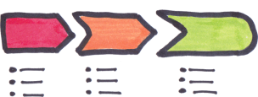


Setup categories and Team Scope
Tech
Process
People
Direct control
Team
Influence
Product
„soup“
Section
Enterprise

Slide 58






Identify teams
Enterprise
Product
Delivery
Support
Total of 44 teams
Analysts
Testers
Devs
Designers
ProductOwners
Managers
ScrumMasters
Team
Not included

Slide 59



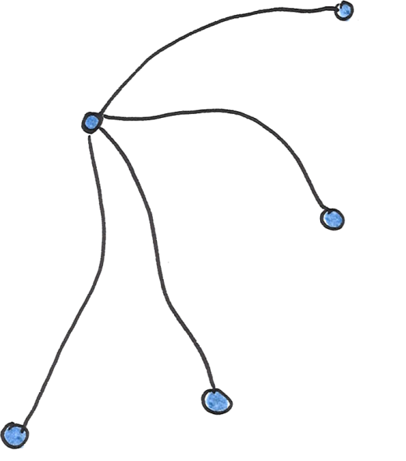



Train the facilitators

Slide 60
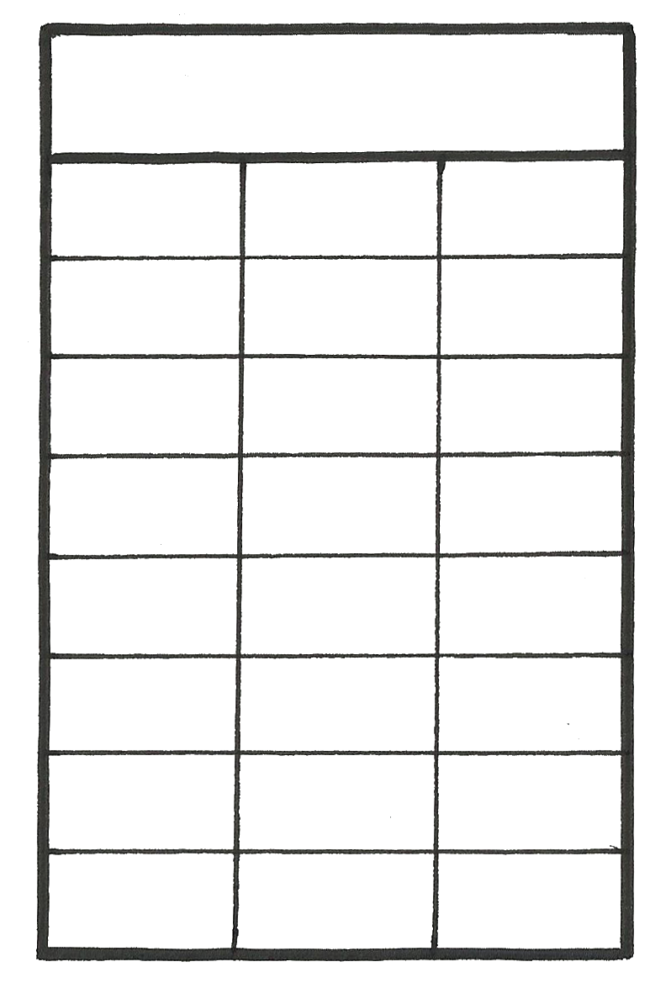
Schedule the games and create facilitation script
Schedule
Time Scope: Last 6 months or last release, whichever is greater.
Team1
Apr 2
Peter
Team2
Apr 2
Juliana
Process Scope: The complete development process from story creation, through development and into production deployment (release to customer).
Team3
Apr 4
Peter
Team4
Apr 5
Greg
Team5
Apr 5
Luke
Team6
Apr 6
Greg
Team7
Apr 7
Juliana
...

Slide 61

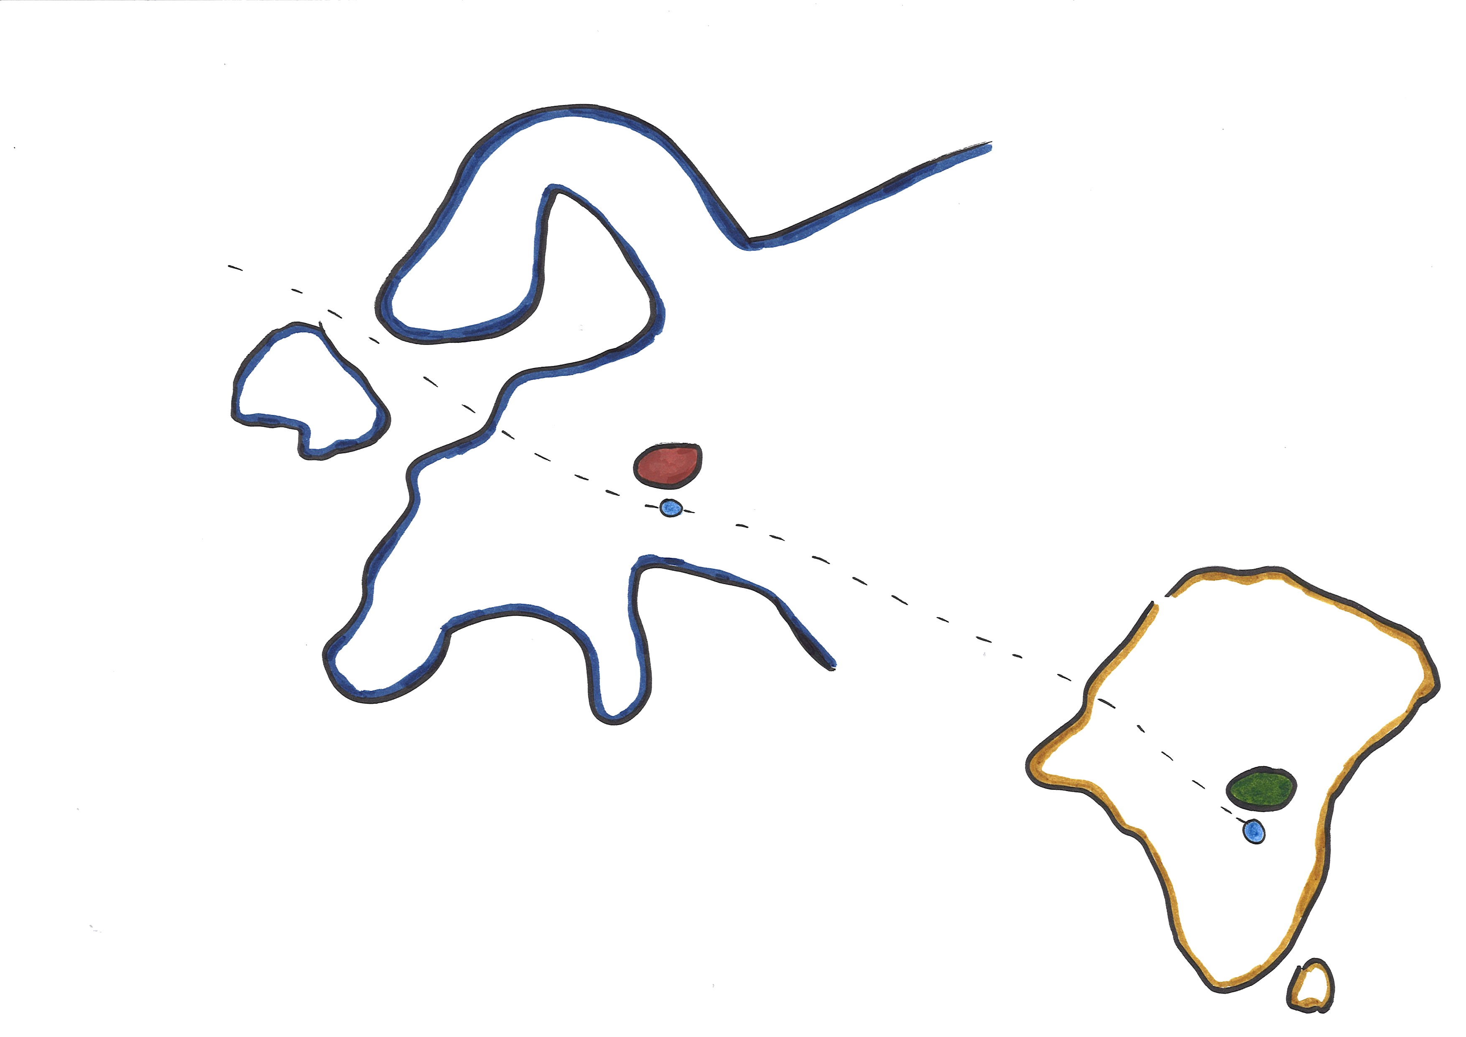


Online platform

Slide 62
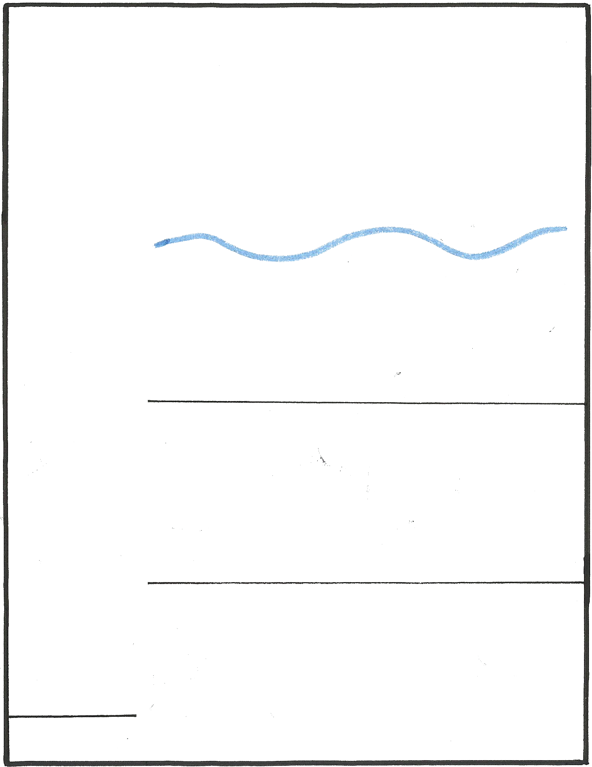












Conducting Retrospectives
Game constraints
...
Really Good
...
Good
=
...
Somewhat Bad
...
=
...
Bad
Really Bad
62

Slide 63


Conducting Retrospectives
Playing the Games
.
= Tech
.
....
= People
= Process
...
.
...
. = Team
.
whisper
.. = Product
... = Section
..
.... = Enterprise
....
...
63

Slide 64
Conducting Retrospectives
Chat Conversation saved
This only happened
once, but I think if
it continues it could
be a problem
I got a good picture
of what we‘ll have
to deliver in the next
few months
API gateway
was down
due to
network
failure
All hands
meeting
explaining
upcoming
initiatives
Maybe we can create
additional checks
in the software
But they failed to
explain the marketing
strategy
Agree, that would be
good and easy to do
Yes that would be a
great addition
next time
64

Slide 65





1000 Resulting Datapoints
Tech
Process
People
Enterprise
Section
Product
Team

Slide 66

Analyzing the Datapoints (Quantitave)
400
Green = Propeller
200
Red = Anchor
100
Enterprise
Section
Product
Team

Slide 67
Analyzing the Datapoints (Quantitave)
400
Green = Propeller
200
Red = Anchor
100
Technology
Process
People

Slide 68
Analyzing the Datapoints (Qualitative)
Product Owners
improved focus
on technical debt
Trust within
Teams is high
Positives
Teams are unsure
about some newly
introduced roles
Insufficient test
Automation and
Test environments
Not production-like
Negatives

Slide 69
Identify follow up Initiatives
Technical on Enterprise level
Bug Burn initiative
“Big picture” architecture Review with consultants
Technical on Team level
Initiate a program of improving skills
Maintain pairing
Process on Enterprise level
Maintain focus on DevOps
Consider a maintenance team to handle existing bug backlog

Slide 70
Outcomes
Bug Burn Initiative
Dedicated 50% of development
to quality improvements for 2-3 Sprints
94 backlogs
Defects (159) + backlog items (107)
Architecture Review
Lego Models
Caching component not stable
Prototype of new Content delivery

Slide 71
Lessons learned
Keep the momentum
How does perception of the enterprise change?
The Retrospective gets people on the same page
Outcomes must be linked to the Retrospective
Better internal communication
More visibility of outcomes
Reporting from other sites
Adoption may vary and fade with leavers
Visual not easy for some people
Need strong facilitators to drive adoption
Apply visual techniques with care

Slide 72
What worked for us
Scaling
Easy to work with online edition of Innovation Games across entire company
Cultural differences do not influence output
Game Constraints directly influence the output
Games in the right context have higher adoption
Buy a Feature popular with POs
Prune the Product Tree used by senior management
Speedboat and other visual techniques used by SMs/Agile Coaches

Slide 73
Summary
Through the Enterprise Retrospectives we were able
to uncover issues at various scope levels and
direct the attention of Management as well as the Teams
to focus the IT organization on improving the
quality of our Software products. Issues that were lurking
since the time of the merger of bwin and Partygaming.
The Retrospective included 42 teams, a total of
285 participants, was run by 20 different facilitators,
and produced 1000 unique anchors and propellers.
The exercise had a lead time of roughly 4 weeks till completion.

Slide 74
Innovation Games gave us an easy way to gather, analyze, and archive honest and insightful feedback from teams within the same context across different cultures and different sites in a company with worldwide operations.

Slide 75
Games give us a context in which we become more open to new things and are willing to go beyond our boundaries. This enhances creativity.

Slide 76
Innovation Games are most powerful when there are lots of unknowns.

Slide 77
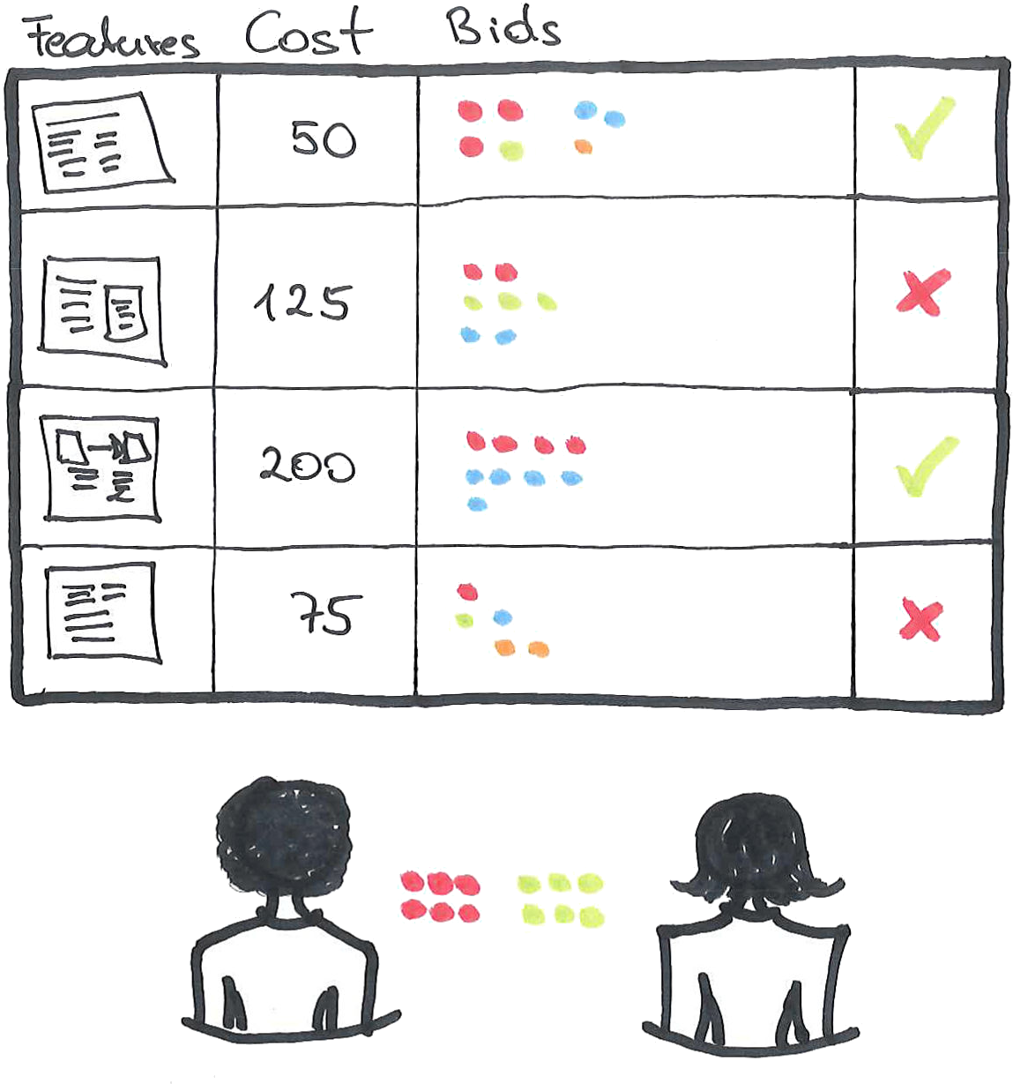
Innovation Games facilitate and shorten feedback loops
Prune the Product Tree
Buy a Feature
Speedboat
Product Box
Spiderweb

Slide 78
Thank you

